Slide 1

Data Science and Bioinformatics Development Lead
Name: Leeroy Njiva

Slide 2

Slide 1: Introduction
Opening Statement:
Hello everyone, today I am presenting my vision for rapid frontline genetic sequence data generation and analysis during a disease outbreak situation, using COVID-19 as a key example.
Genetic sequencing has been instrumental in managing disease outbreaks. For instance, during the COVID-19 pandemic, genetic sequencing allowed us to track the virus's mutations and spread, enabling timely public health responses.

Slide 3
Slide 2: Vision Overview
Key Points:
My vision revolves around creating an efficient, rapid, and accurate genetic sequencing system that can be deployed during outbreaks. Speed and accuracy in genetic data generation are crucial for containing diseases. Equally important is making this technology accessible to regions worldwide, ensuring no area is left behind during a crisis.

Slide 4
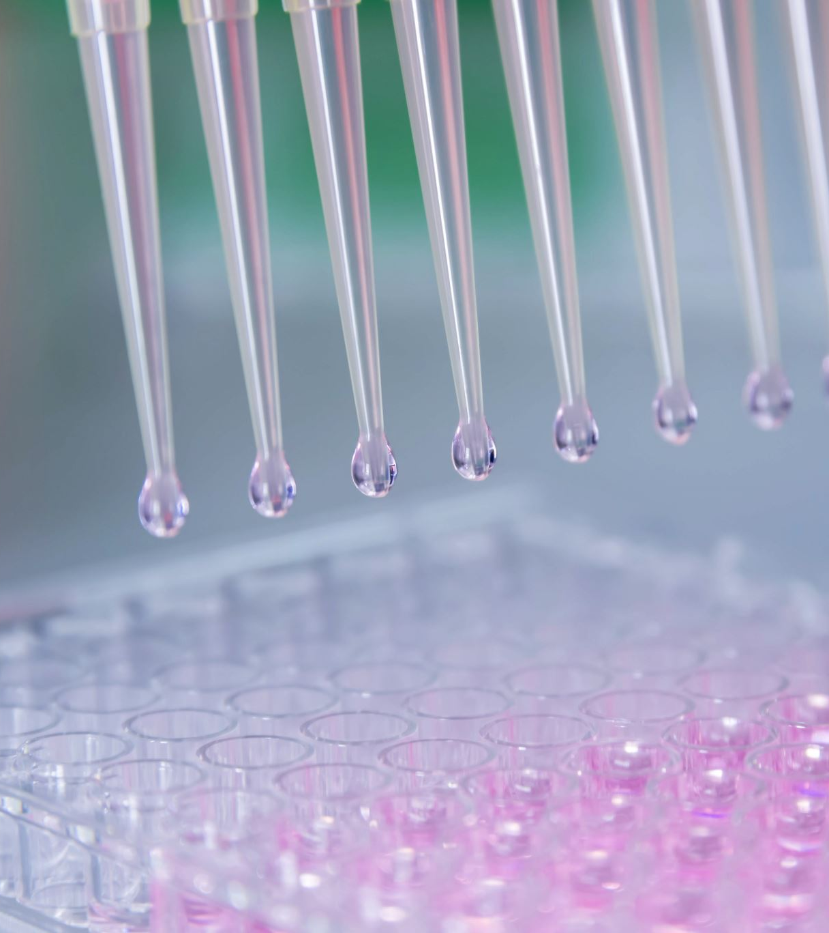
Slide 3: Rapid Genetic Sequence Data Generation
Technological Advances:
Advances in technology, such as portable sequencing devices like the Oxford Nanopore MinION, have revolutionized the field. Automation and AI play a significant role in expediting the sequencing process, allowing for quick and reliable results.

Slide 5
Operational Strategy:
I propose a decentralized approach where mobile sequencing units are deployed to outbreak hotspots. These units can be operated by local personnel trained to use this technology, ensuring immediate data generation at the source.

Slide 6
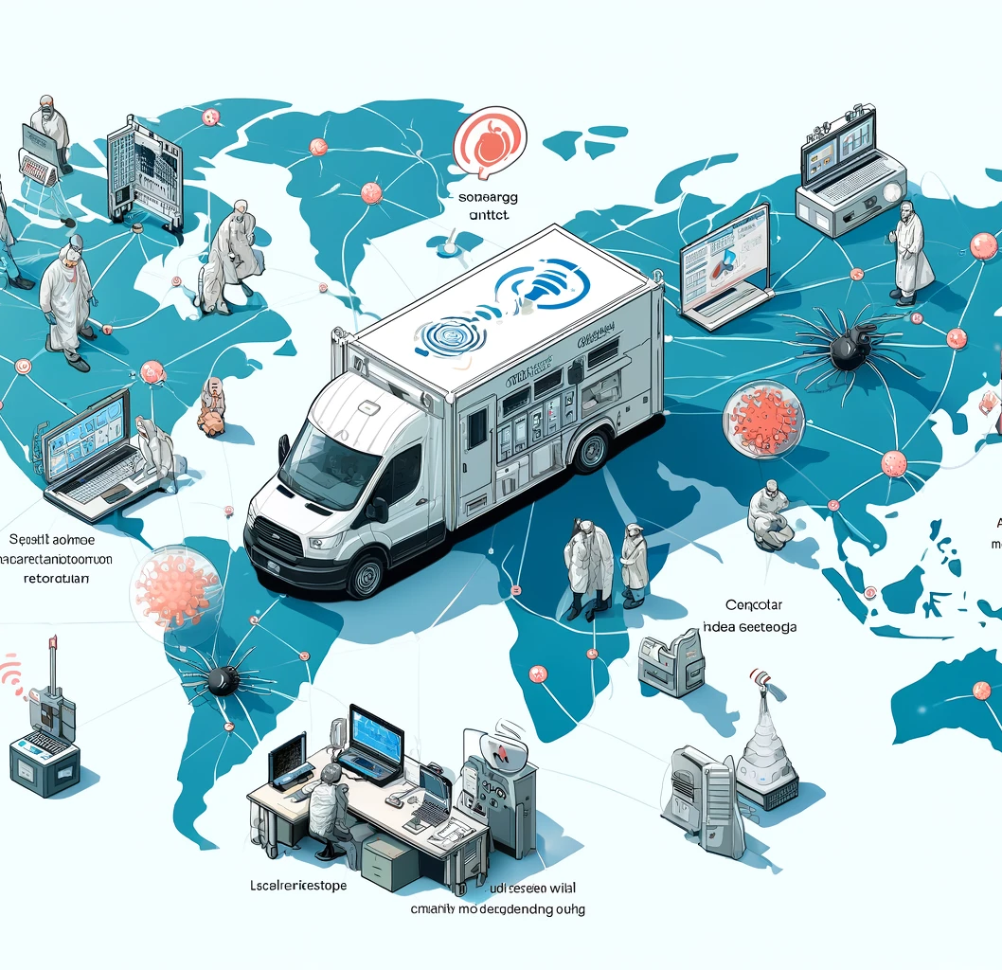
Decentralized Approach with Mobile Sequencing Units
Description:
This illustration depicts a decentralized approach to responding to disease outbreaks using mobile sequencing units. These units, such as vans or portable labs, are deployed at various outbreak hotspots on a global map. Local personnel are shown operating these units with laptops and sequencing equipment, generating data in real-time. Data transmission to a central cloud platform is represented by icons and symbols, emphasizing the speed and efficiency of this method. Additionally, the image highlights the importance of training local teams, showing a small group being instructed on using the equipment.
Importance:
By decentralizing the approach and utilizing mobile sequencing units, we can ensure immediate data generation at the source of an outbreak. This method allows for rapid identification and response, which is crucial in controlling the spread of diseases. Training local personnel enhances the sustainability and effectiveness of this strategy, empowering communities to manage outbreaks swiftly and independently.

Slide 7

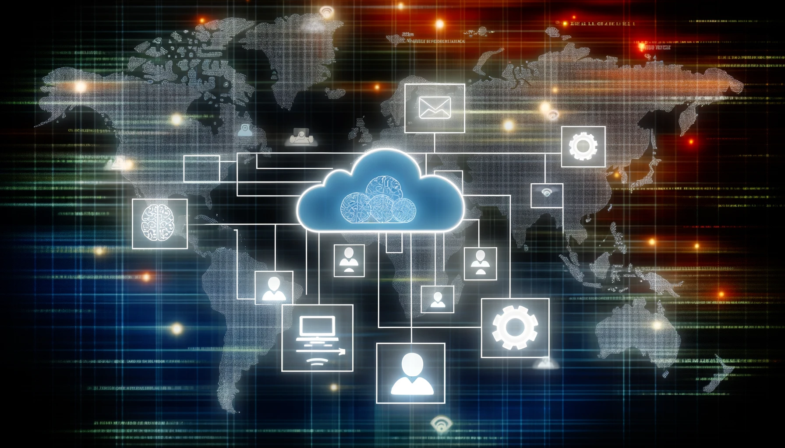
Slide 4: Data Analysis Framework
Real-Time Data Processing:
Utilizing cloud-based platforms for real-time data sharing and analysis is essential. AI and machine learning can facilitate rapid pathogen identification and mutation tracking, providing crucial information almost instantaneously.
Collaboration and Data Sharing:
Global collaboration is key. Open data platforms, such as GISAID and Nextstrain, have proven successful in facilitating this. Sharing data globally ensures a coordinated and effective response to outbreaks.

Slide 8
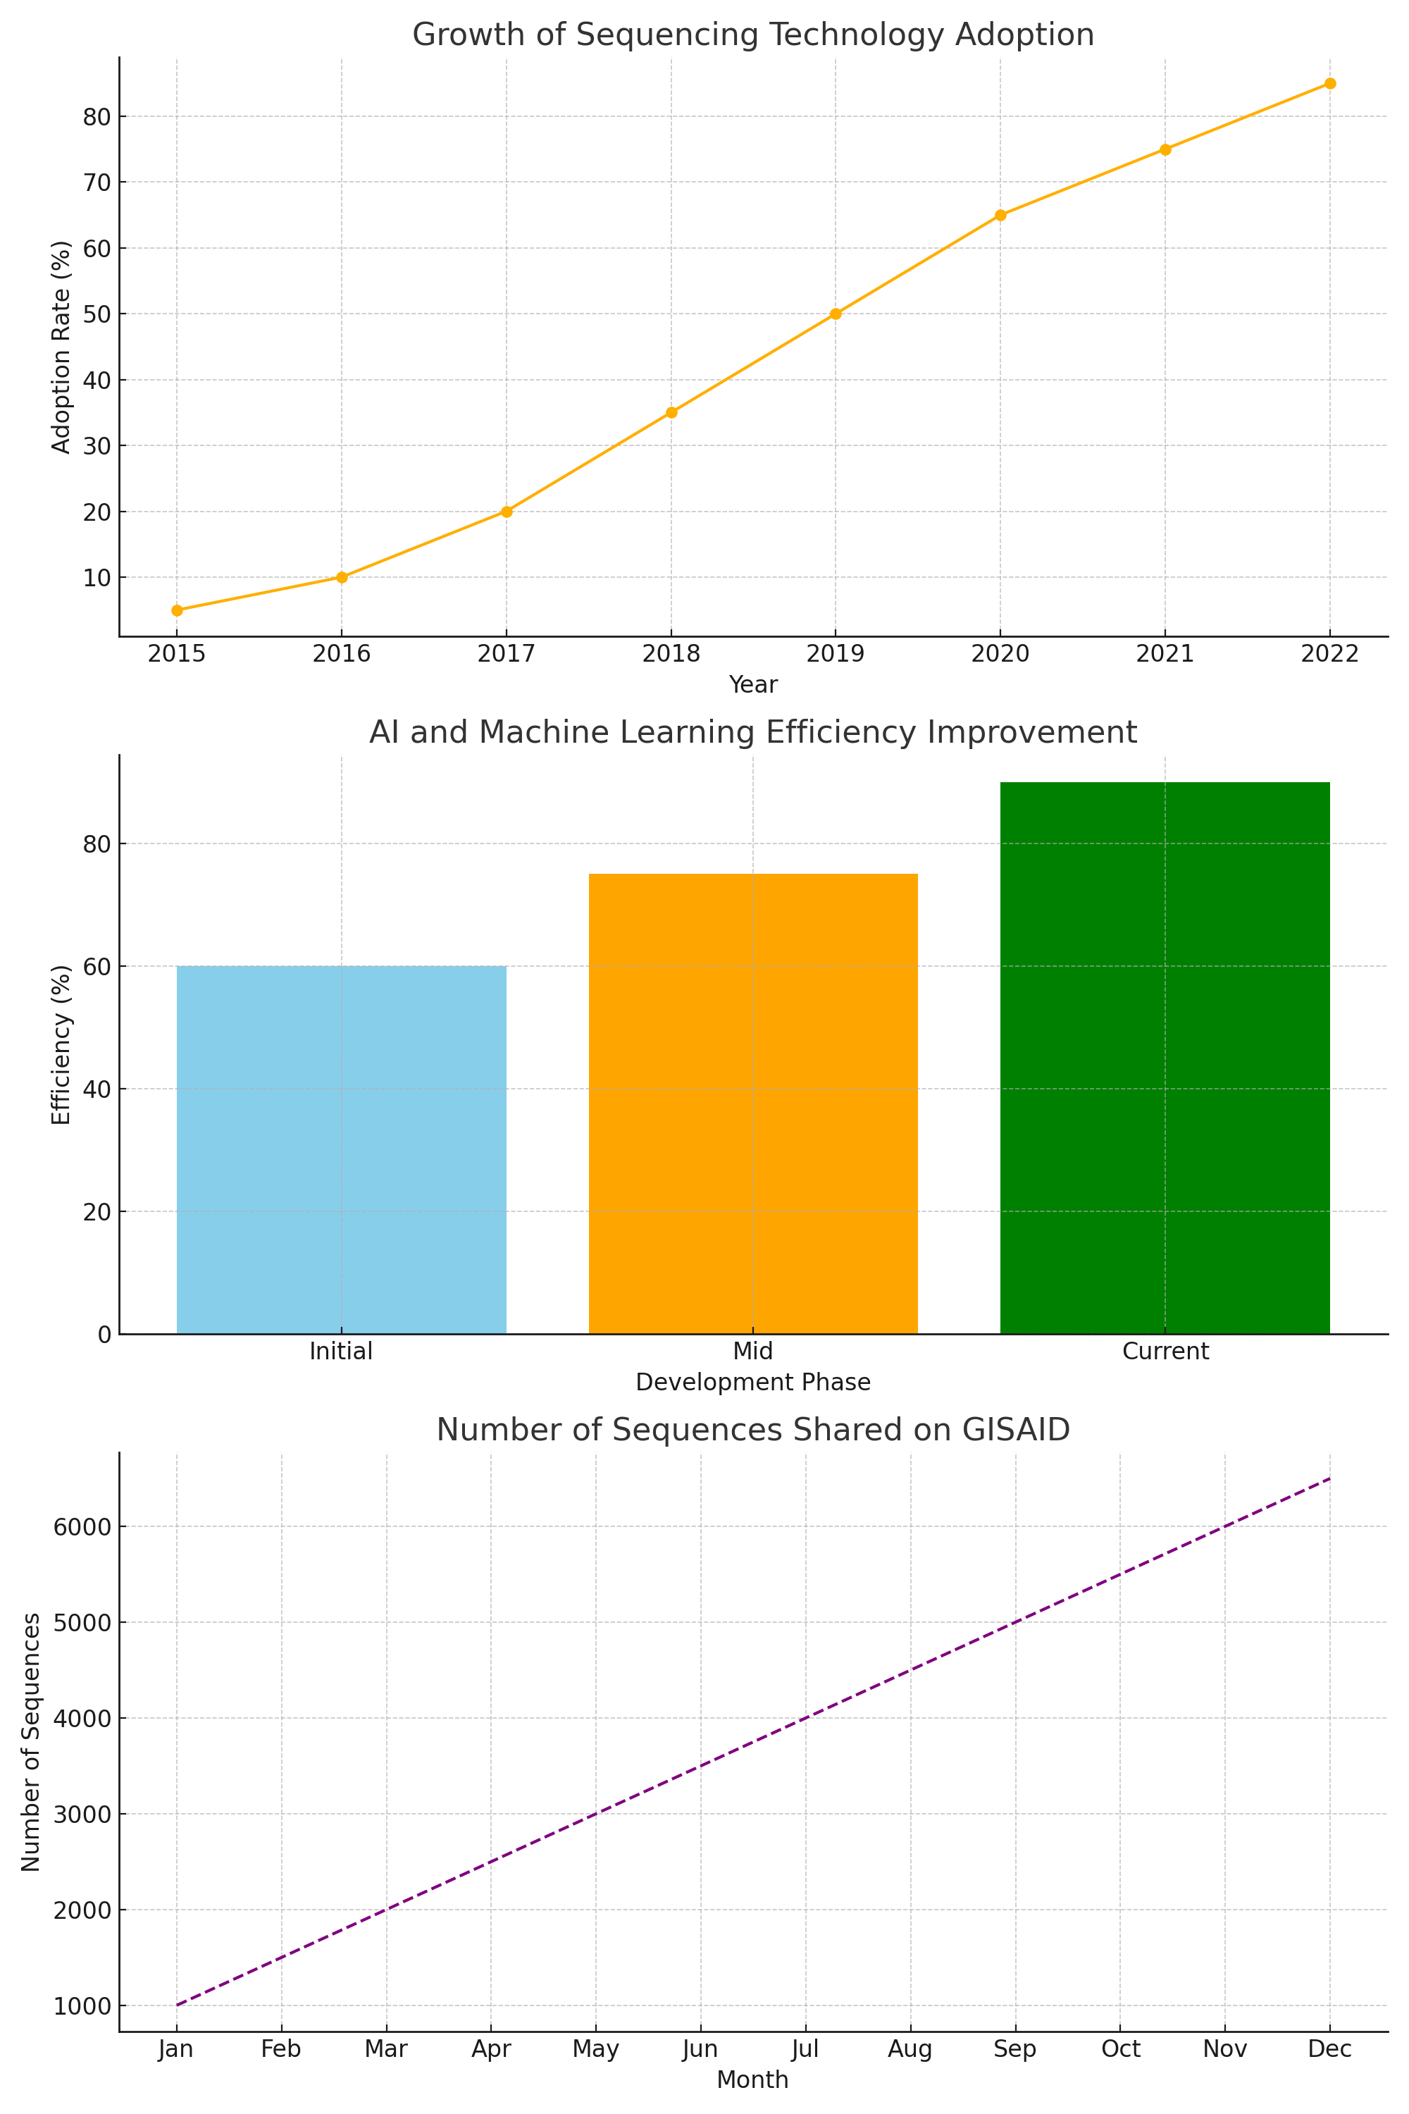
Here are the visual aids to simplify complex concepts for the presentation on rapid genetic sequencing and data analysis during a disease outbreak, specifically focusing on COVID-19:
Visual Aid 1: Growth of Sequencing Technology Adoption
This line chart illustrates the increasing adoption rate of sequencing technology over the years, showing significant growth from 2015 to 2023.
Visual Aid 2: AI and Machine Learning Efficiency Improvement
This bar chart depicts the efficiency improvements in AI and machine learning for genetic data analysis across different development phases, highlighting the advancements in these technologies.
Visual Aid 3: Number of Sequences Shared on GISAID
This line chart shows the monthly number of sequences shared on the GISAID platform, emphasizing the global collaboration and data sharing efforts during the outbreak.
You can download and include these visuals in your presentation from the following link: Covid Project Visuals.
These visual aids will help convey the project's key concepts more effectively, making the presentation engaging and easier to understand. ​​

Slide 9
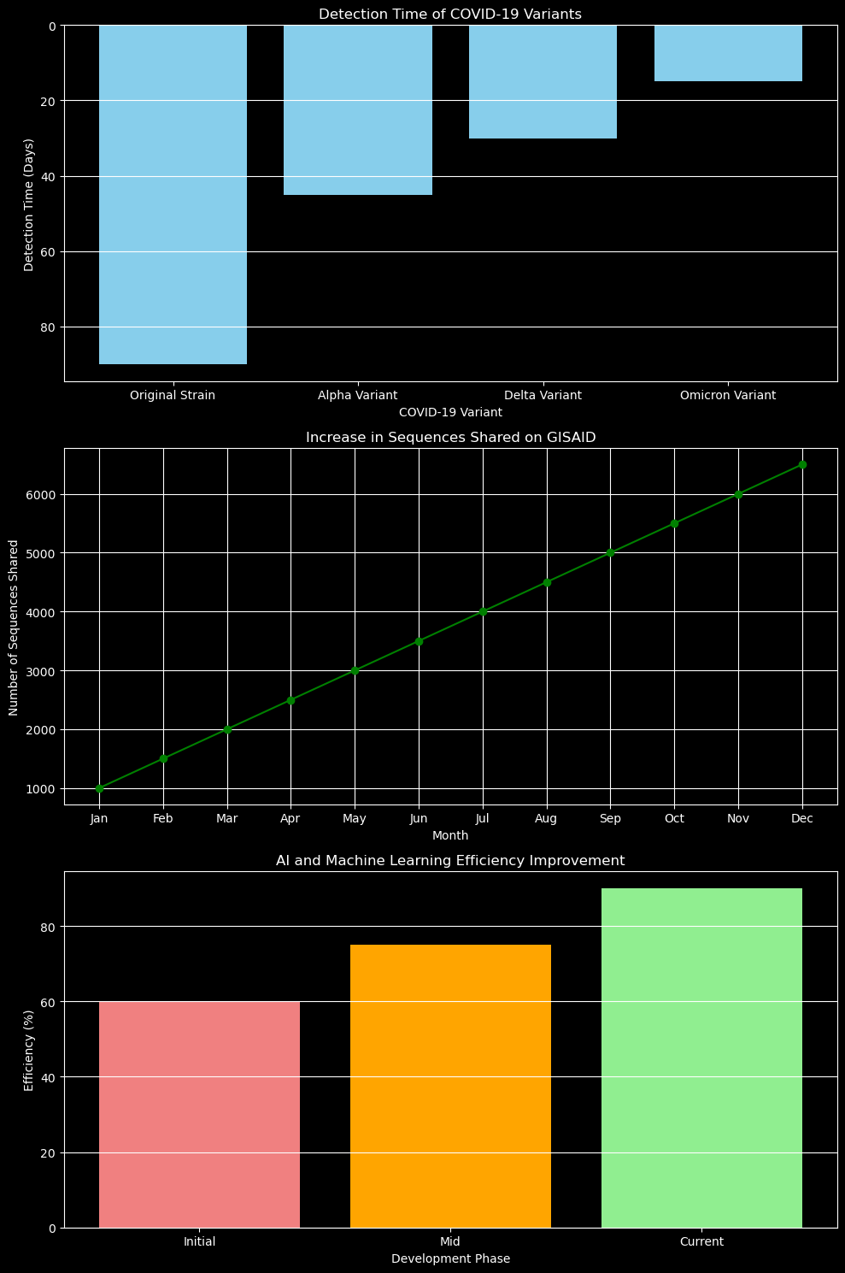
Detection Time of COVID-19 Variants
Description: This chart shows the time it took to detect different COVID-19 variants from the start of the pandemic. The variants included are the Original Strain, Alpha, Delta, and Omicron. As shown, the detection time has significantly decreased over time:
Original Strain: 90 days
Alpha Variant: 45 days
Delta Variant: 30 days
Omicron Variant: 15 days
This reduction in detection time highlights the improvements in genetic sequencing technology and the efficiency of our response systems. Faster detection means we can identify and understand new variants quickly, allowing for timely public health actions and better control of the outbreak.
Chart: Increase in Sequences Shared on GISAID
Description: This chart illustrates the number of COVID-19 genetic sequences shared on the GISAID platform over the course of a year. The data shows a steady increase from January to December, with the number of sequences growing from 1,000 to 6,500.
This growth demonstrates the importance of global collaboration and data sharing during a pandemic. By sharing genetic data, scientists around the world can monitor the virus's evolution in real-time, track the spread of different variants, and develop strategies to combat the disease more effectively.

Slide 10
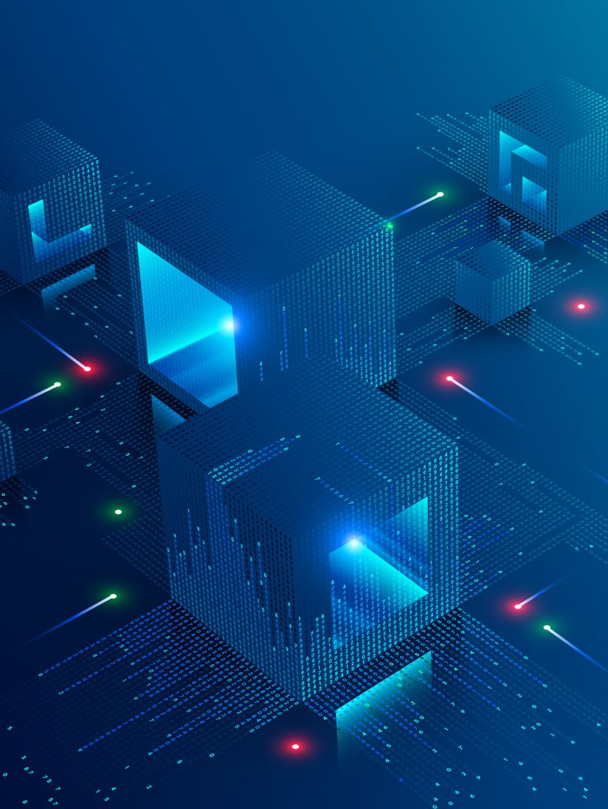
Slide 5: Challenges and Solutions
Challenges:
Several challenges must be addressed, including data privacy and security, infrastructure limitations in low-resource settings, and ensuring data accuracy and integrity.
Proposed Solutions:
Implementing robust cybersecurity measures is vital to protect data privacy. Developing portable, solar-powered sequencing kits can overcome infrastructure limitations in remote areas. Establishing international standards for data collection and reporting will ensure data accuracy and integrity.

Slide 11

Personal Anecdotes and Case Studies
Anecdote 1: Personal Experience with Rapid Sequencing
When the COVID-19 pandemic first hit, I was part of a research team working around the clock to sequence the virus's genome. I remember the sense of urgency and the long hours spent in the lab, knowing that our work could help identify how the virus was spreading and evolving. This firsthand experience showed me the critical importance of rapid genetic sequencing in real-time decision-making during an outbreak.
Case Study 1: Tracking Variants with Genetic Sequencing
Early in the pandemic, researchers in the UK identified a new variant of the virus, later known as the Alpha variant. Through rapid genetic sequencing, they were able to determine that this variant was more transmissible than the original strain. This discovery led to immediate public health actions, such as targeted lockdowns and increased vaccination efforts, which helped control the spread of the variant. This case highlights how genetic sequencing can provide crucial information quickly, guiding effective responses.

Slide 12

Anecdote 2: Community Impact of Data Sharing
During the pandemic, I worked with a team that was part of a global effort to share genetic data on platforms like GISAID. We uploaded sequences from our local cases and accessed data from other regions. I remember how collaborative and supportive the global scientific community was during this time. Sharing data openly allowed us to compare our findings, spot trends, and react faster to emerging threats. This experience reinforced my belief in the power of global collaboration in fighting diseases.
Case Study 2: Decentralized Sequencing in Remote Areas
In early 2021, a team deployed portable sequencing units to remote areas in Africa where COVID-19 testing facilities were scarce. These units, operated by local health workers, allowed for on-site sequencing of virus samples. The data collected helped identify outbreaks early and enabled timely interventions, such as setting up quarantine zones and distributing medical supplies. This initiative demonstrated how decentralizing sequencing capabilities can be a game-changer in resource-limited settings.

Slide 13

Summary
These anecdotes and case studies illustrate the real-world impact of rapid genetic sequencing and data sharing during the COVID-19 pandemic. By sharing these stories, I hope to convey the importance of continuing to invest in and innovate this crucial area of public health.

Slide 14
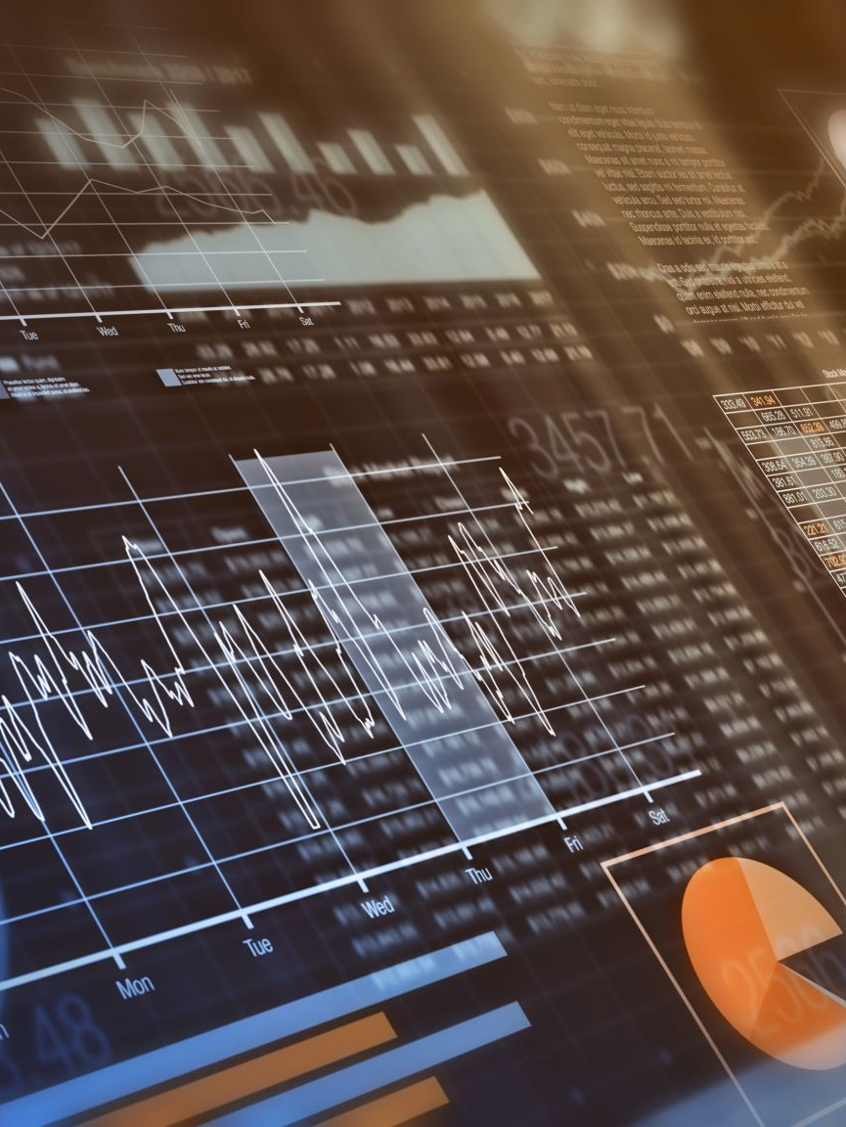
Slide 6: Conclusion and Call to Action
Summary:
In conclusion, rapid genetic sequencing and analysis are paramount in managing disease outbreaks. My vision is to establish a future where real-time genetic data is integral to outbreak response, enabling swift and effective action.
Call to Action:
I urge investment in sequencing technologies and infrastructure, as well as international cooperation and continuous innovation in this field. Together, we can enhance our ability to respond to future outbreaks effectively.
End of Presentation:
Now, I welcome any questions and look forward to discussing how these ideas can be implemented in real-world scenarios.

